Slide 1
L12.01 Dynamic Programming III
50.004 Introduction to Algorithm
Dr. Simon LUI
ISTD, SUTD

Slide 2
Objectives
More DP problems with different structure
Parenthesization
Longest common subsequence
Activity scheduling
Introduction to greedy algorithm

Slide 3
Parenthesization

Slide 4
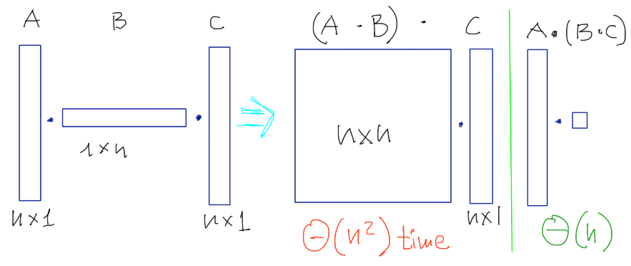
Parenthesization
Example: matrix multiplication

Slide 5
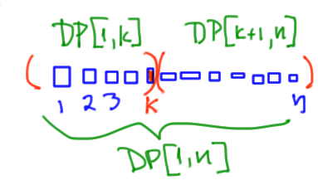
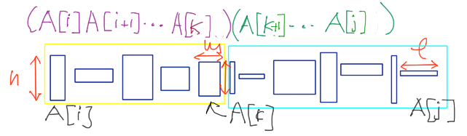
Guessing: outermost multiplication
-> # of choices = O(n)
Recurrence:

Slide 6
Question: The topological order to solve the sub-problems is
in increasing prefix order (1, 12, 123, 1234,…)
in decreasing suffix order (n,(n-1)n , (n-2)(n-1)n,…)
in increasing substring size (1,2,…,n, 12,23,…(n-1)n, 123, 234,…)

Slide 7
Guessing: outermost multiplication
-> # of choices = O(n)
Sub-problems:
cost of substring A[i:j]
Recurrence:
Topological sort: solve sub-problems in increasing size
(Answer of QS in P.5 = (3))

Slide 8
<- k*
Let’s look at an example now

Slide 9
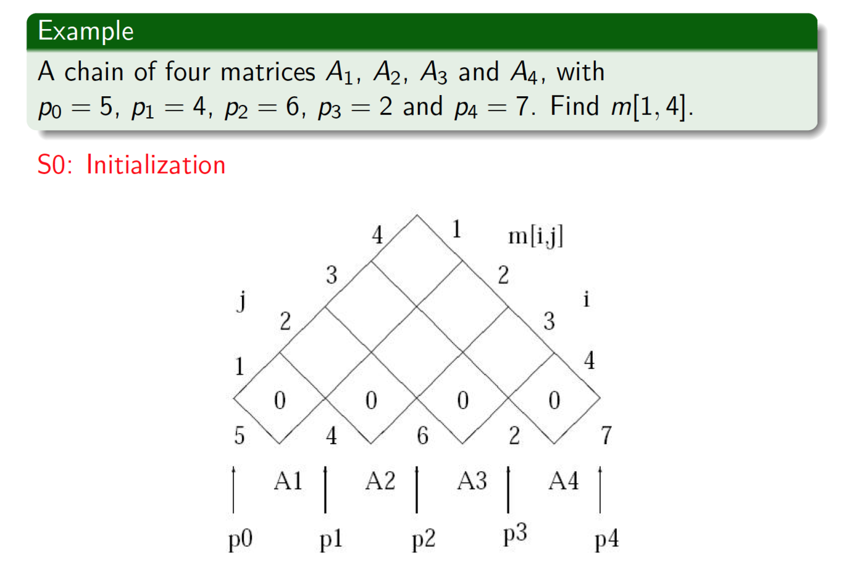

Slide 10
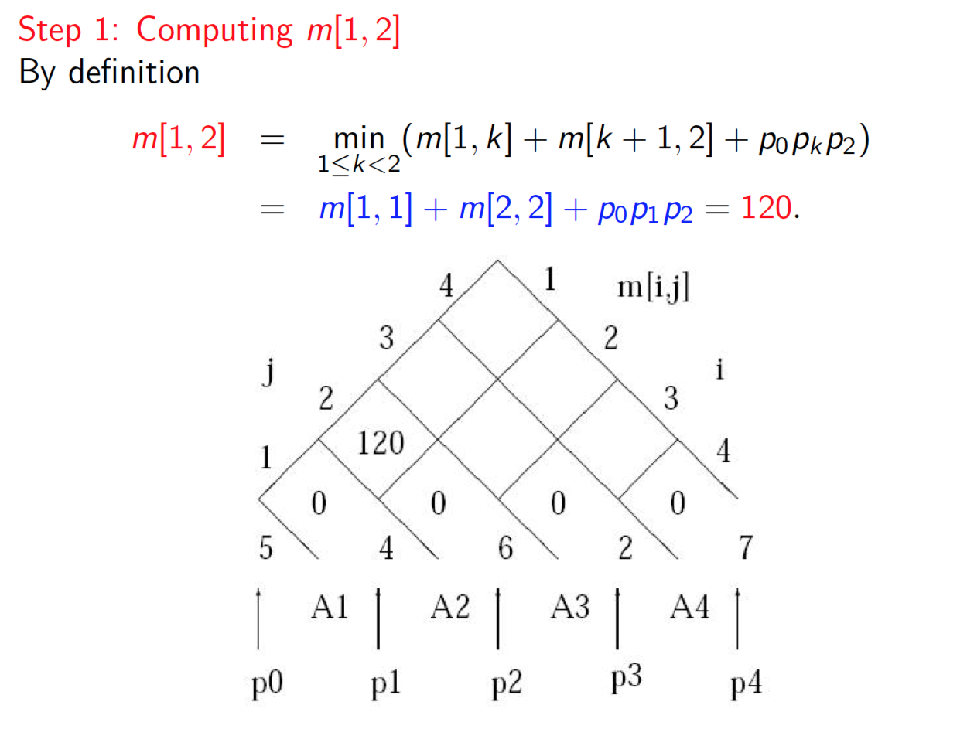

Slide 11
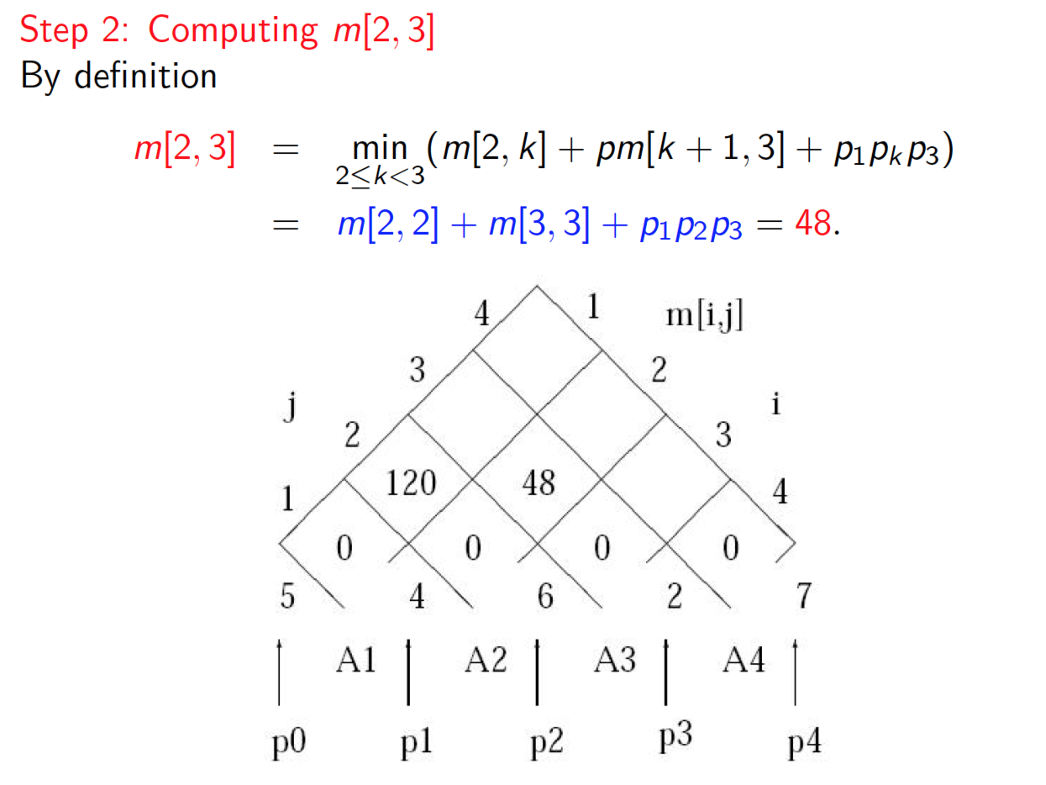

Slide 12
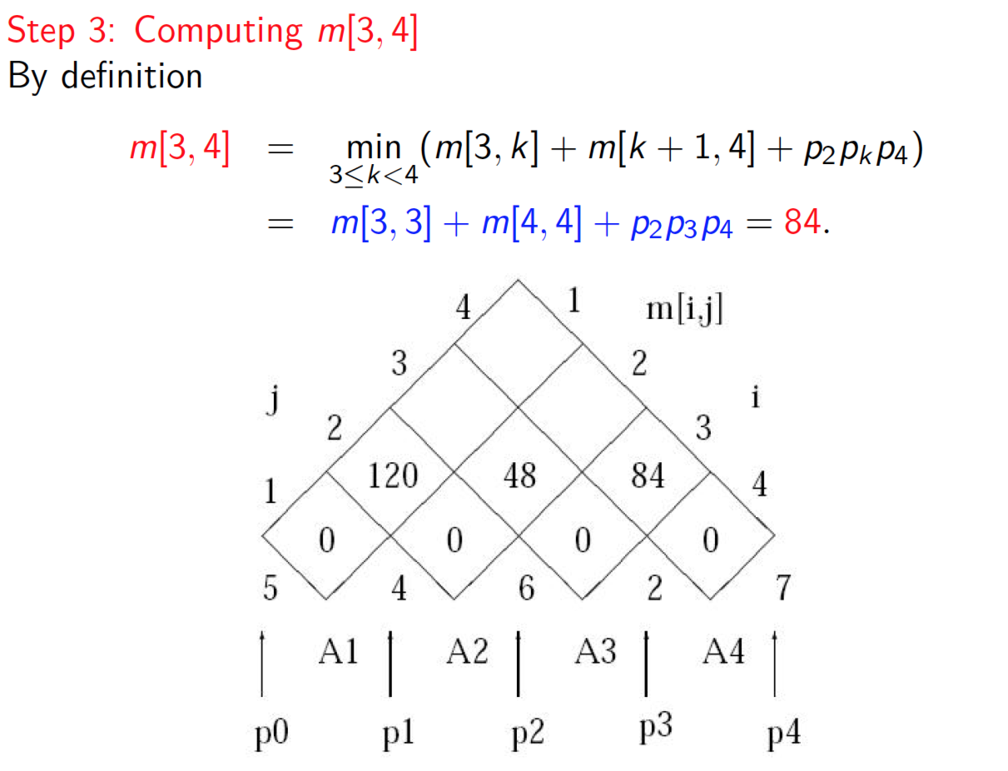

Slide 13
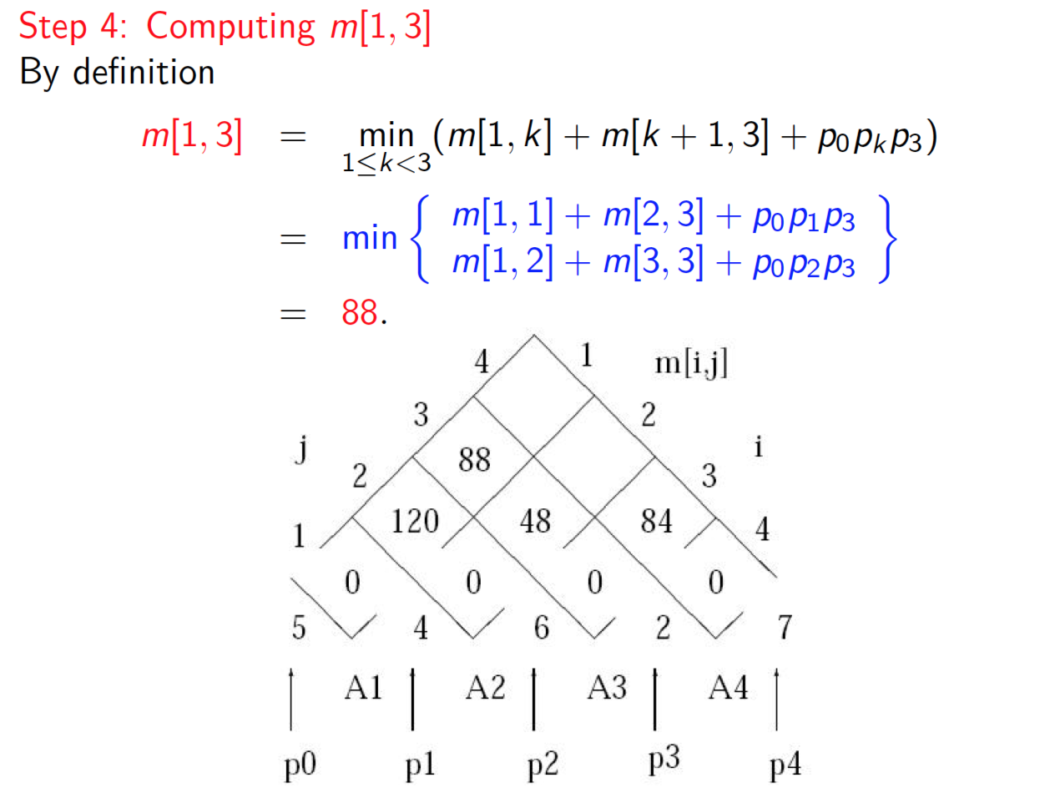

Slide 14
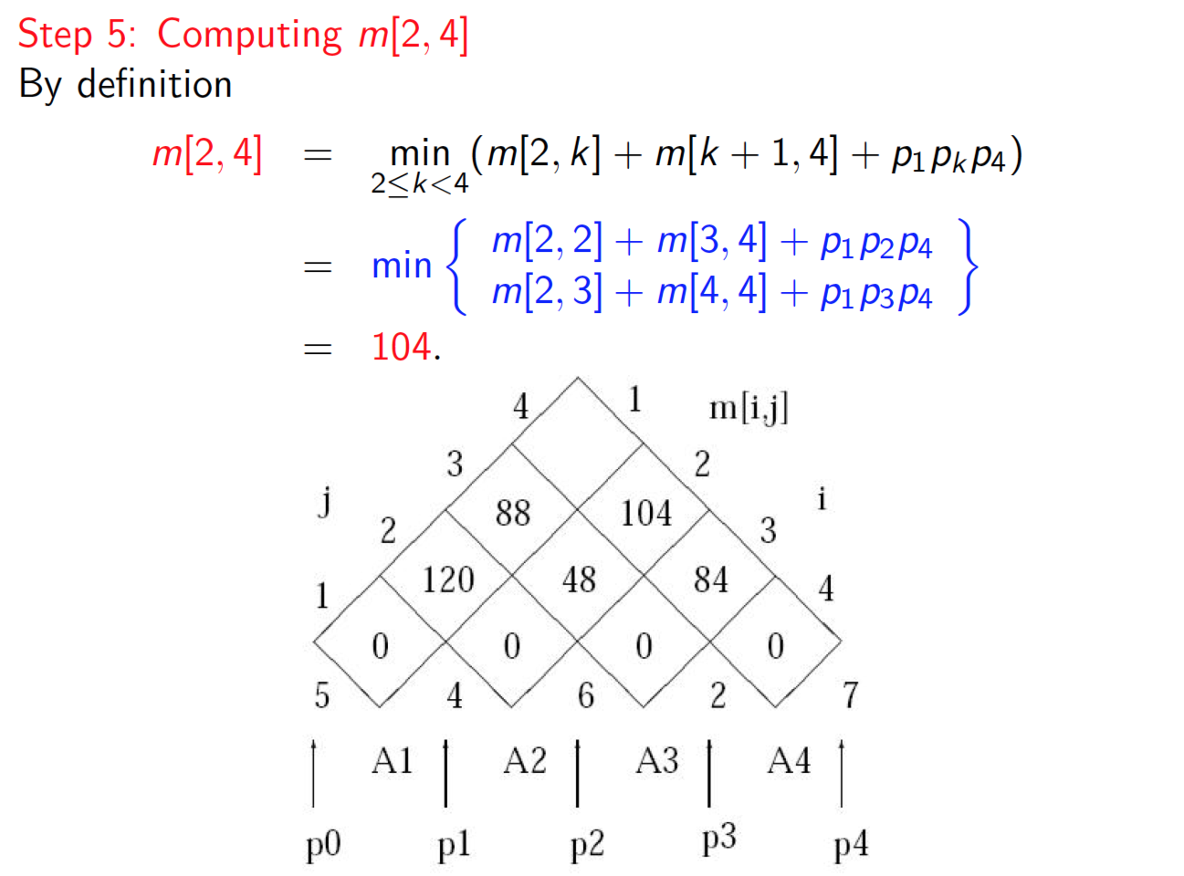

Slide 15
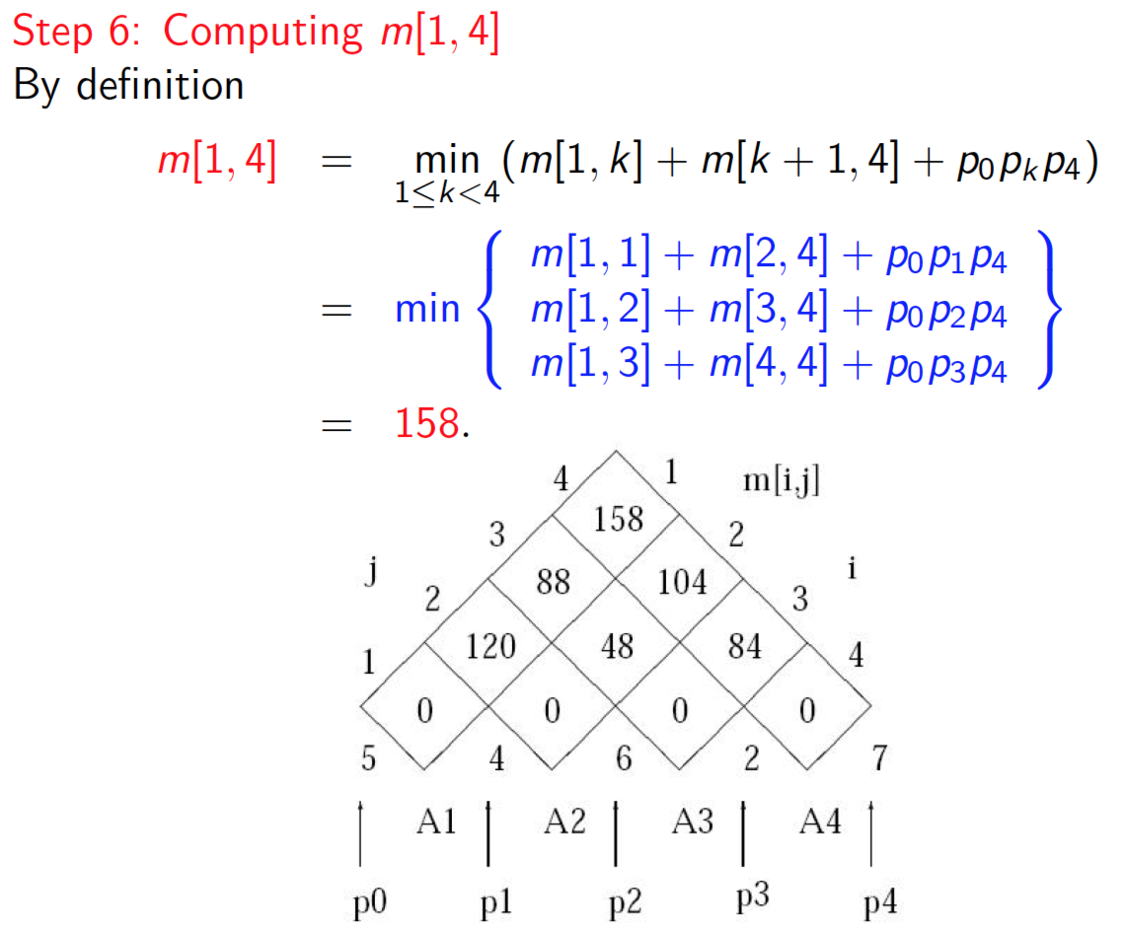

Slide 16
Exercise
<- k*
Use DP to find the most efficient way to compute
(5,1) (1,5) (5,1) (1,4) (4,2)
 | 1 | 2 | 3 | 4 | 5
1 | DP[1,1] | DP[1,2] | DP[1,3] | DP[1,4] | DP[1,5]
2 |  | DP[2,2] | DP[2,3] | DP[2,4] | DP[2,5]
3 |  |  | DP[3,3] | DP[3,4] | DP[3,5]
4 |  |  |  | DP[4,4] | DP[4,5]
5 |  |  |  |  | DP[5,5]

Slide 17
Exercise - Solution
Use DP to find the most efficient way to compute
(5,1) (1,5) (5,1) (1,4) (4,2)
 | 1 | 2 | 3 | 4 | 5
1 | DP[1,1] = 0 | 25, k*=1 | 10, k*=1 | 29, k*=1 | 25, k*=1
2 |  | DP[2,2] = 0 | 5, k*=2 | 9, k*=3 | 15, k*=3
3 |  |  | DP[3,3] = 0 | 20, k*=3 | 18, k*=3
4 |  |  |  | DP[4,4] = 0 | 8, k*=4
5 |  |  |  |  | DP[5,5] = 0

Slide 18
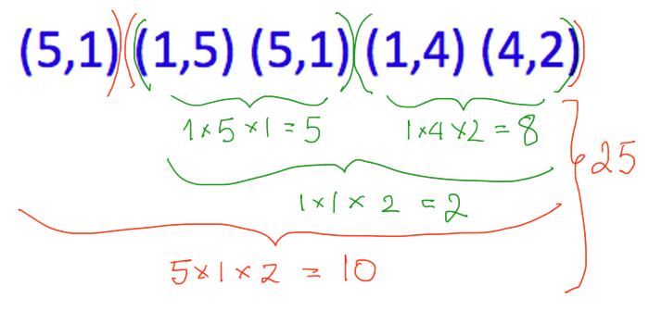
 | 1 | 2 | 3 | 4 | 5
1 | DP[1,1] = 0 | 25, k*=1 | 10, k*=1 | 29, k*=1 | 25, k*=1
2 |  | DP[2,2] = 0 | 5, k*=2 | 9, k*=3 | 15, k*=3
3 |  |  | DP[3,3] = 0 | 20, k*=3 | 18, k*=3
4 |  |  |  | DP[4,4] = 0 | 8, k*=4
5 |  |  |  |  | DP[5,5] = 0

Slide 19
Longest common subsequence

Slide 20
Longest common subsequence (LCS)
Given two strings x and y find the size of a longest common substring z of x and y
Application: Given two strings x and y, find the “cheapest” number of edits to transform x into y
Edit ops: cost(insert, c) , cost(delete, c), cost(replace, c->c’)
Cost of transformation = sum of costs of all edit ops
If insert cost = delete cost =1, replace cost = ∞, then = LCS
x = H I E R O G L Y P H O L O G Y
y = M I C H E L A N G E L O
cost = |x|+|y|-2|z|
Notes:
DNA: mutation C->G low cost

Slide 21
Optimal substructure of an LCS
Find the LCS of sub-problems
Case1: x = X₁X₂…X_{n-1} A
y = Y₁Y₂…Y_{m-1} A
Case2: x = X₁X₂…X_{n-1} A
y = Y₁Y₂…Y_{m-1} B
Clearly LCS(x,y) = LCS’A
LCS’ = LCS of x[1..n-1] and y[1..m-1]
Then either A or B or both are not part of a LCS
CLS(x,y) = CLS(x[1..n],y[1..m-1]), or CLS(x,y) = CLS(x[1..n-1],y[1..m])
Hence CLS(x,y) =
max{CLS(x[1..n],y[1..m-1]), CLS(x[1..n-1],y[1..m])}

Slide 22
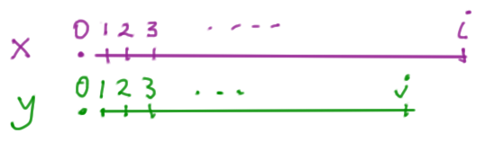
The DP formulation
Sub-problems: DP[i,j]
Recursion:
 | 0 | 1 | 2 | 3 | 4
0
1
2
3
DP[1,2]

Slide 23
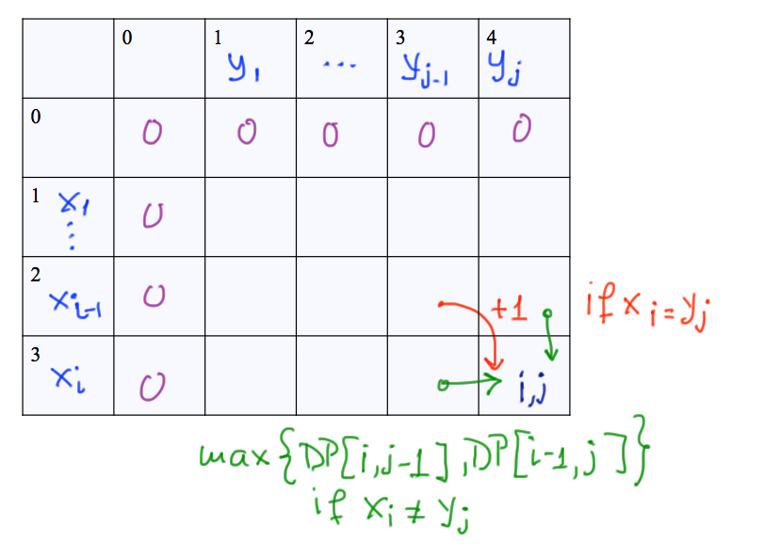

Slide 24
The DP formulation
Sub-problems: DP[i,j] (i.e., x[1..i], y[1..j])
Recursion:
Topological sort:
Solution: DP[3,4]
 | 0 | 1 | 2 | 3 | 4
0
1
2
3

Slide 25
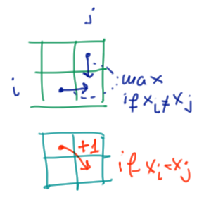
Example: (CLRS Fig 15.8)
BDCABA
ABCBDAB
 | J | 0 | 1 | 2 | 3 | 4 | 5 | 6
i |  | y_{i} | B | D | C | A | B | A
0 | x_{i} | 0 | 0 | 0 | 0 | 0 | 0 | 0
1 | A | 0
2 | B | 0
3 | C | 0
4 | B | 0
5 | D | 0
6 | A | 0
7 | B | 0

Slide 26
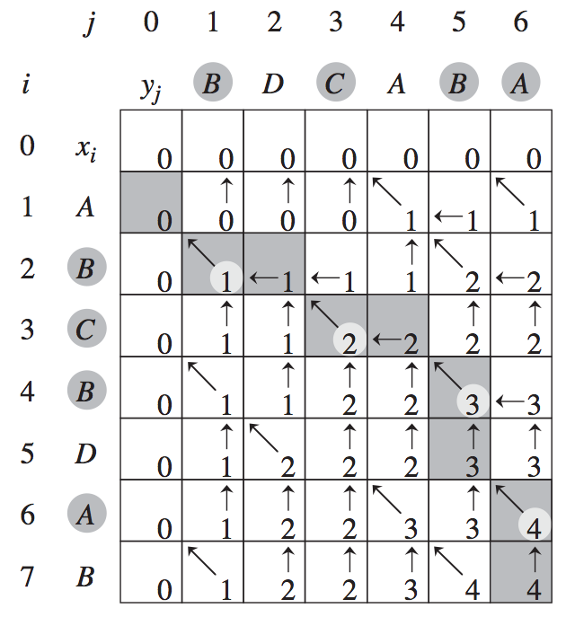
Example: (CLRS Fig 15.8)

Slide 27
Exercise
Find the longest common subsequence of
AGCGA and CAGATAGAG

Slide 28
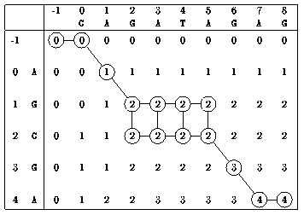
Exercise - Answer
Find the longest common subsequence of
AGCGA and CAGATAGAG

Slide 29
Activity scheduling

Slide 30
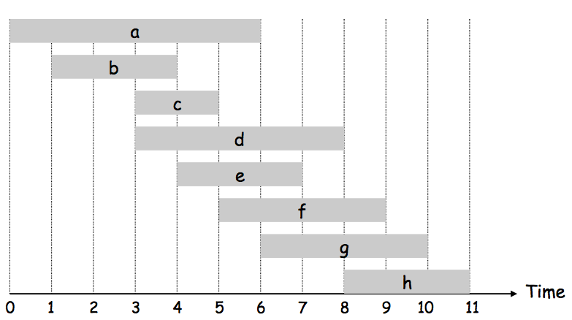
Activity scheduling

Slide 31
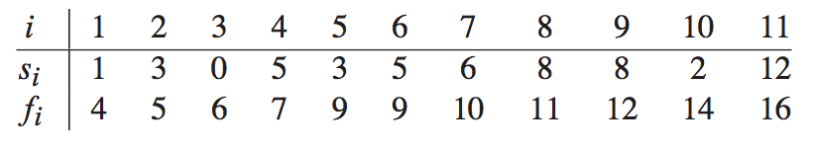
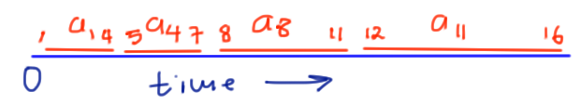
Activity scheduling
We are given a set of n activities S={a₁,…,a_{n}}, each with a known starting time s_{i} and finishing time f_{i}.
Two activities are compatible if they don’t overlap.
We want to find the max number of compatible activities.
Assume that
Example:
n*=4

Slide 32
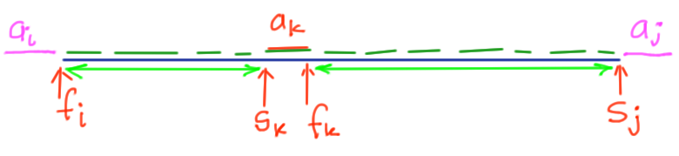
Solution 1
S_{ij} = set of activities that start after activity i finishes and end before activity j starts.
DP[i,j]: optimal solution of activities in S_{ij}
Recurrence:

Slide 33
Introduction to Greedy algorithm

Slide 34
Solution 2
Greedy algorithm: always choose the locally optimal choice without caring for how this affects the future
(In general it is not optimal)
Question: which of the following policies is the best?
A. schedule the activity that has the shortest duration first
B. schedule the activity with the earliest finishing time first
C. schedule the activity with the earliest start time first

Slide 35
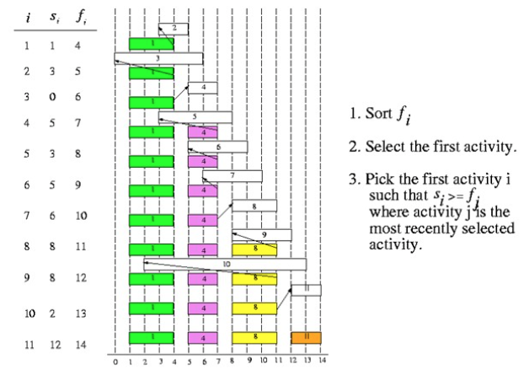
Example – greedy algorithm

Slide 36
Observation: it is always optimal to schedule first the activity with the earliest finishing time!
…Hence less constraints in the future!
We will talk about Greedy Algorithm in the next lecture

